Slide 1
SELF-PRESENTATION .NET DISCIPLINE
<Victor Avtandilyan>
<July 2024>
CONFIDENTIAL | © 2024 EPAM Systems, Inc.

Slide 2
About me
Software Engineer with 5+ years of experience, 5+ years in .NET
My core skills:
.NET technologies such as ASP.NET Core, Entity Framework
Relational and Non-Relational databases
Authentication, Authorization, Role base access control, HMAC, OAuth2
Cloud platforms (mostly Azure)
My focus areas:
Web API development, Desktop apps, Database management
Project management and ownership
Learning, teaching and sharing experience in understandable way
<Name>

Slide 3
Working experience/career path overview
Started the career with Database first monolith desktop project with custom ORM and business logic handled in SQL SPs and Functions then moved to microservices Web APIs with EF as the ORM.
(Make this more visible during migration) Simultaneously started and managed my pet project to help my fitness trainer to work with his trainees online seamlessly and promptly where I involved my friends and created tasks for them on GitHub Project with diagrams and detailed descriptions.
2019
Mersoft – CRM, Warehouses, hotels, clinics (Developer)
Title: Software engineer
2021
VOLO – shipment management cargo
(Developer)
Title: Software engineer
2022
EPAM – Swiss Re – re-insurance company
(Developer)
Title: Software engineer
2023
EPAM – Philip Morris – Tobacco domain
(developer)
Title: Software engineer
2023
EPAM - S&P Global (Key Developer)
2024
EPAM - LSEG – (Senior Developer)
Title: Software engineer

Slide 4
DEVELOPMENT EXPERIENCE AND KNOWLEDGE
Notes:
DEVELOPMENT EXPERIENCE AND KNOWLEDGE
L3:
At least 3 years of relevant development experience, including UML, Modeling and Design skills
Has Advanced level of theoretical knowledge and production experience in at least one technical area
Recommended
Has multiple technical areas of expertise
Participated in technical interviews
Participated in mentoring programs or was a mentor for less experienced colleagues
Conducted trainings or tech talks in their area of expertise
Participated as speaker on internal or external conferences (e.g. SEC online)
L4:
At least 5 years of relevant development experience, including UML, Modeling and Design skills, and expert knowledge of at least one technical area
Has at least one Expert or several Advanced levels of skills related to their primary technology skill
Has at least one full cycle project participation experience or participated in several projects covering different phases of the development lifecycle
Knows and can explain how to start a new project from scratch from a technical point of view
Able to conduct technical interviews
Recommended
Recognized mentor in mentoring programs
Conducted trainings or tech talks on their expert area
Participated as speaker on internal or external conferences (e.g. SEC online)
ROLES PLAYED ON A PROJECT
L3:
Plays the Key Developer and Software Architect roles. May sometimes play Development Team Lead and Project Coordinator role
Key developer. Takes responsibility for the design and implementation of system components
Plays active part in the process of requirements (e.g. task, user story) decomposition and planning, and refining both functional and non-functional requirements
Recommended
Has experience with leading small development teams (1-3 developers)
L4:
Plays the Key Developer and Software Architect roles, and usually also performs a Development Team Lead, Project Coordinator, Reviewer or Auditor role
There might be two roles with different focus:
Development Team Leader of an engineering team, with hands-on technical experience:
The main focus is on team leadership, clarifying requirements, removing impediments and blockers, and also spending time on managerial activities
Responsible to have the picture of the whole project itself, to know the architecture and potential technical and non-technical risks
Technical Leader on a team of engineers:
The main focus is on system design. Responsible for complex solutions and component designs, implementations and delivery. Knows and controls non-functional requirements. Communicates with on-site / peer architects and mentors all other team members to improve their skills in their expert ar
CUSTOMER RELATIONS
L3:
Expected to participate in phone conferences; be interviewed by customers; visit customers with supervision
Actively participates in project meetings, including meetings with customers; May present own or team results
Able to directly communicate with a customer in areas of requirements gathering and refinement, doing demos, showing results of own work
Recommended
Has success story of convincing a customer to implement own or team-proposed technical solution
L4:
Expected to participate in phone conferences; be interviewed by customers; be involved in customer workshops and presentations; visit customers without supervision
Plays customer-facing role
Able to propose suitable technical solutions that solves customer needs; Can provide correct arguments why a given solution should be chosen, and also able to propose alternative approaches
Able to present technical solutions to the customer
Recommended
Able to work on-site with the customer

Slide 5
DEV EXPERIENCE: <EPAM Swiss Re> — page 1/2
OVERVIEW
Business
Key facts
Domain – Reinsurance company
Period of involvement: <STARTDATE> - <ENDDATE>
Team of 9 people
Main stack: .NET, PostgreSQL
Infrastructure: Azure, Microservices, Docker
High level Technical architecture
Microservices powered by dapper sidecar, deployed on Azure
Tech stack
.NET
Postgresql
Azure

Slide 6
DEV EXPERIENCE: <EPAM Swiss Re> — page 2/2
MY PARTICIPATION
MY ROLES
My key achievements
Integrate Azure Cognitive Search as a separate microservice
Implement new features, refactor complex, unmaintainable code and fix bugs
<Lengthy explanation of decisions you made>
<Other lengthy explanations>
Refactored custom dynamic questionnaire using PredicateBuilder and hiding all the logic in methods so the main method would be easily readable thanks to verbose methods signature for better readability and maintainability.
Created services for Azure Search with methods such as repository with CRUD operations that supports convenient querying, service that utilizes Azure Search SDK for documents indexation, re-indexation, creation and deletion.
Highlights
<Most interesting/challenging technical work you’ve done>
What: Integrated Azure Search to transfer and store data from PostgreSQL to optimize read operations.
Challenging parts: It wasn’t straight forward because by the time I was implementing there was lacking support from Azure’s library for .NET (NuGet). So, I had to dig the documentation and find right endpoints to make a HTTP request, check the response and wrap it into convenient service class methods.

Slide 7
DEV EXPERIENCE: <EPAM Philip Morris> — page 1/3
OVERVIEW
Business
Key facts
Domain – tobacco production
Period of involvement: <STARTDATE> - <ENDDATE>
Team of 4 people (back, front, dev ops, product owner)
Tobacco producer
Main stack: .NET Web API, MSSQL, Docker, AWS
High level Technical architecture
Web API with clean architecture

Slide 8
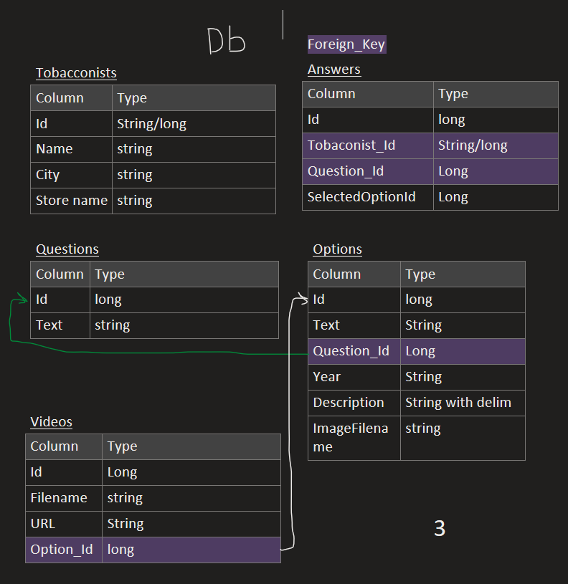
DEV EXPERIENCE: <EPAM Philip Morris> — page 2/2
MY PARTICIPATION
MY ROLES
DB schema draft example
Developed from scratch a backend service which serves client’s feedback questionary that had to be displayed in tobacco stores in France.
My key achievements
Quickly delivered a scalable, maintainable Web API with growth potential by implementing clean architecture principals.
Questions and answers were stored in database which made it dynamic and easy to alter.
Change questionnaire content without front or back-end application deployment.
Future proof for more features such as reports and more.
The data could be used ported and used in data warehouses for analyzing the answers and generate aggregated feedbacks.

Slide 9
DEV EXPERIENCE: <EPAM S&P Global> — page 1/2
OVERVIEW
Business
Key facts
Stocks market
Stand alone code pieces that syncs data in database when another dependent data is changes. Involves complex business logic and sometimes recursion and functional programming mostly for hierarchical structures.
Period of involvement: <STARTDATE> - <ENDDATE>
Team of 8 people
Stocks
Custom transactional and eventual consistency services
High level Technical architecture
Tech stack
.NET,
MSSQL,
Kafka,
xUnit, BDD
Huge project with different parts that interact with each other via message brokers (mainly Kafka), I can’t call it microservices.

Slide 10
DEV EXPERIENCE: <EPAM S&P Global> — page 2/2
MY PARTICIPATION
MY ROLES
My key achievements
As a key developer in a newly formed team I was accumulating information from both technical and business people and sharing it with my team
Helped my peers to debug and understand big, hard to read SQL queries.
Understand legacy code from last decades and bring it to new standards.
This project was mostly about communication and acquiring knowledge, best practices from more experienced teams
Got rid of recursive and chatty db calls by making a single query to db and getting all necessary info and then manipulate with data in recursive manner. Understood 20 years old code with Boolean flags that change behavior of the code and even scope that involves. It was tough. Covered it with unit tests.
Optimized derivation logic that was taking 23 seconds to 1.3 seconds (17 times faster), got rid of nested and heavy loops, made use of HashSets for quicker lookups, etc..
Escalated cases that UAT team didn’t notice before.
OTHER
Dramatically improved time and space complexity. Made life of future engineer easier with better code and well documented logic in Markdown format with examples and ready to test queries.

Slide 11
DEV EXPERIENCE: <EPAM London Stock Exchange> — page 1/2
OVERVIEW
Business
Key facts
Stocks market
Period of involvement: June 2024 - Present
Team of 5 people
<Business domain>
<Technology stack>
<Other important information>
High level Technical architecture
e.g. <“Monolith with 10 products, micro-services high load, etc.”>
<“Any technically important details that helps to understand complexity of the project”>
<“Future growth from technical perspective”>
<“Add diagrams in architecture section”>

Slide 12
DEV EXPERIENCE: <EPAM London Stock Exchange > — page 2/2
MY PARTICIPATION
MY ROLES
My key achievements
STILL ONBOARDING PROCESS
<Lengthy, detailed explanation of your roles and responsibilities>
<Lengthy explanation of decisions you made>
<Other lengthy explanations>
OTHER
<Most interesting/challenging technical work you’ve done>
<Any other facts that cover requirements for the position, e.g.
L3: https://kb.epam.com/display/EPMASMT/.NET+Discipline%3A+Requirements+for+L3+position
L4: https://kb.epam.com/display/EPMASMT/.NET+Discipline%3A+Requirements+for+L4+position >
<etc.>

Slide 13
DESIGN AND DOCUMENTATION SKILLS
Notes:
DESIGN AND DOCUMENTATION SKILLS
L3:
Able to read and understand project and requirement documentation; Able to create design, technical and project documentation including high-quality documentation of their code
Has experience in creating system/module design and/or its components. Able to explain pros and cons of proposed solutions
Able to explain the non-functional requirements on the current and previous projects
Able to explain and use design patterns
Able to read and create unambiguous, and easy to understand software engineering diagrams
Has experience in writing technical documentation
Recommended
Has experience in proposing technical solutions or enhancements
L4:
Able to read and understand project and requirement documentation; Able to create high-quality design, technical and project documentation including documentation of their code; Able to write high-quality non-functional requirement specifications and audit documentation
Has experience designing system components or whole solutions; Able to explain pros and cons of proposed solutions
Able to explain the non-functional requirements on the current and previous projects
Able to create unambiguous and easy to understand software engineering diagrams
Knows architecture design patterns (e.g. SOA, event-driven architecture, microservices); Able to fully describe patterns used on his project, and able to compare these patterns
Has experience in writing technical documentation according to best practices
Recommended
Has experience writing Statement of Work and User Manuals
Has experience in proposing technical solutions or enhancements

Slide 14
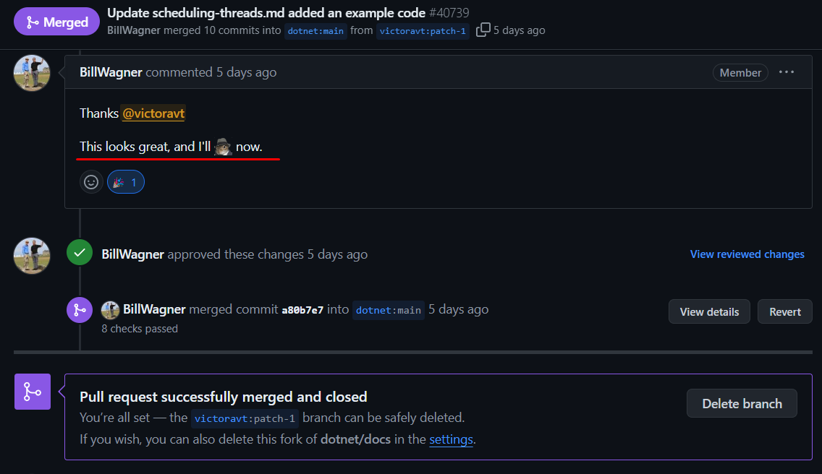
DESIGN AND DOCUMENTATION SKILLS: My participation high level
I’ve been maintaining a GitHub project where the tasks have been written by me in Markdown format, understandable and readable with cognitive ease.
I contribute in Microsoft’s .NET docs where I described Threads priority level and produced a code snippet which illustrated the behavior of threads prioritization. (https://github.com/dotnet/docs/pull/40739)
I shared some experience also in StackOverflaw and keen to continue doing so
I wrote article on Medium
Some examples ->
<What you did, how did you contribute>
<Your experience in architecting systems, applications: diagrams, explanations, non-functional requirements, etc.>
<Examples of diagrams you’ve created on your projects>
<Your experience in creating technical documentation>.

Slide 15
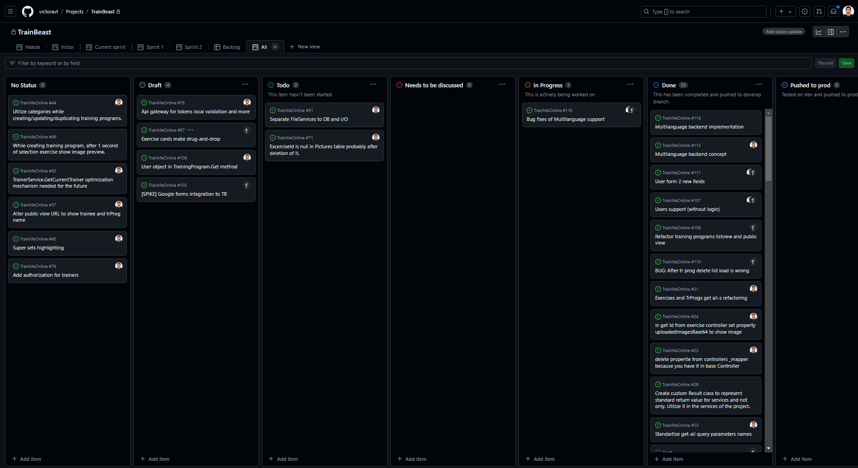
DESIGN AND DOCUMENTATION SKILLS
TrainBeast pet project
View of the project’s board with all the tickets

Slide 16
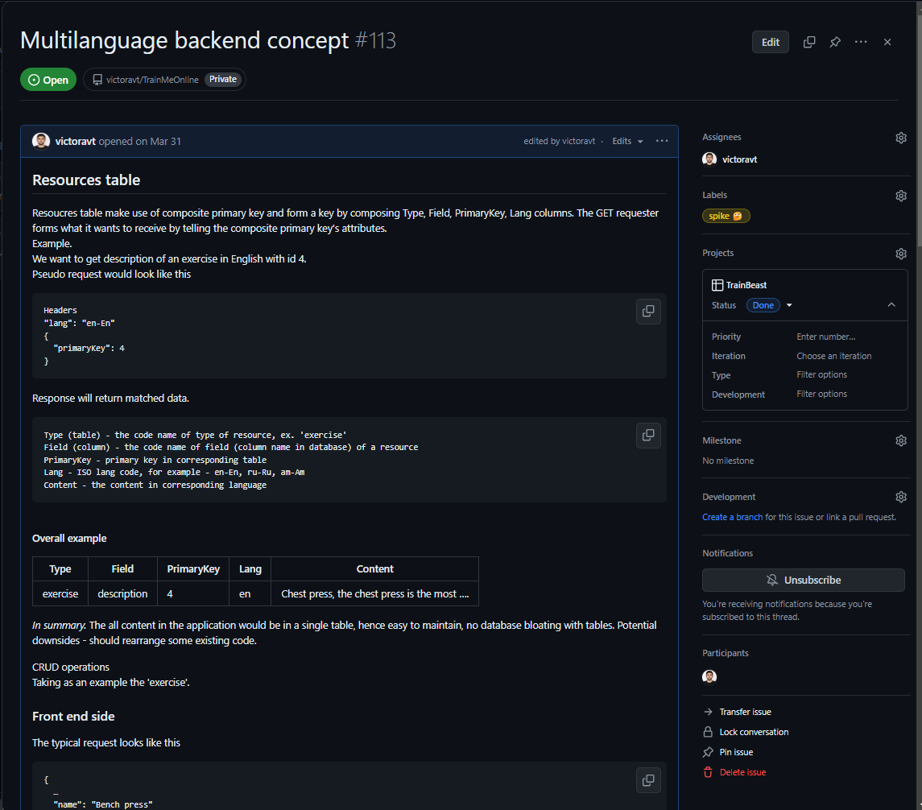
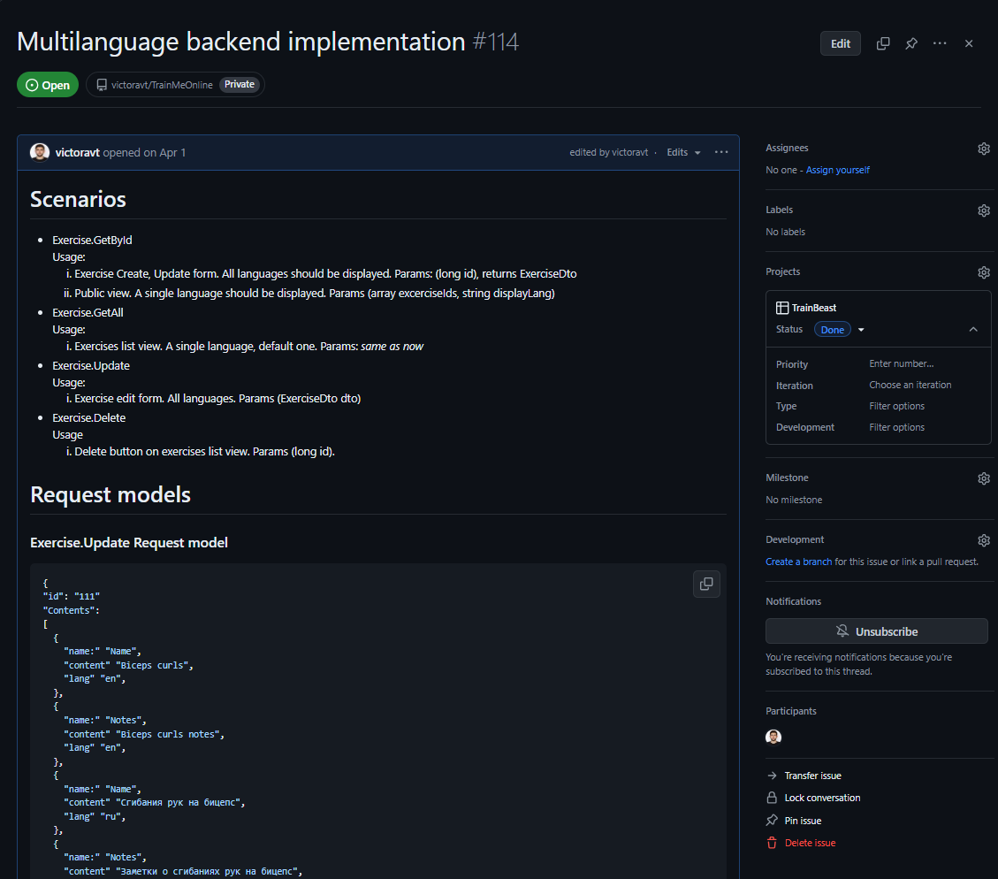
DESIGN AND DOCUMENTATION SKILLS
TrainBeast pet project
Ticket/task examples

Slide 17
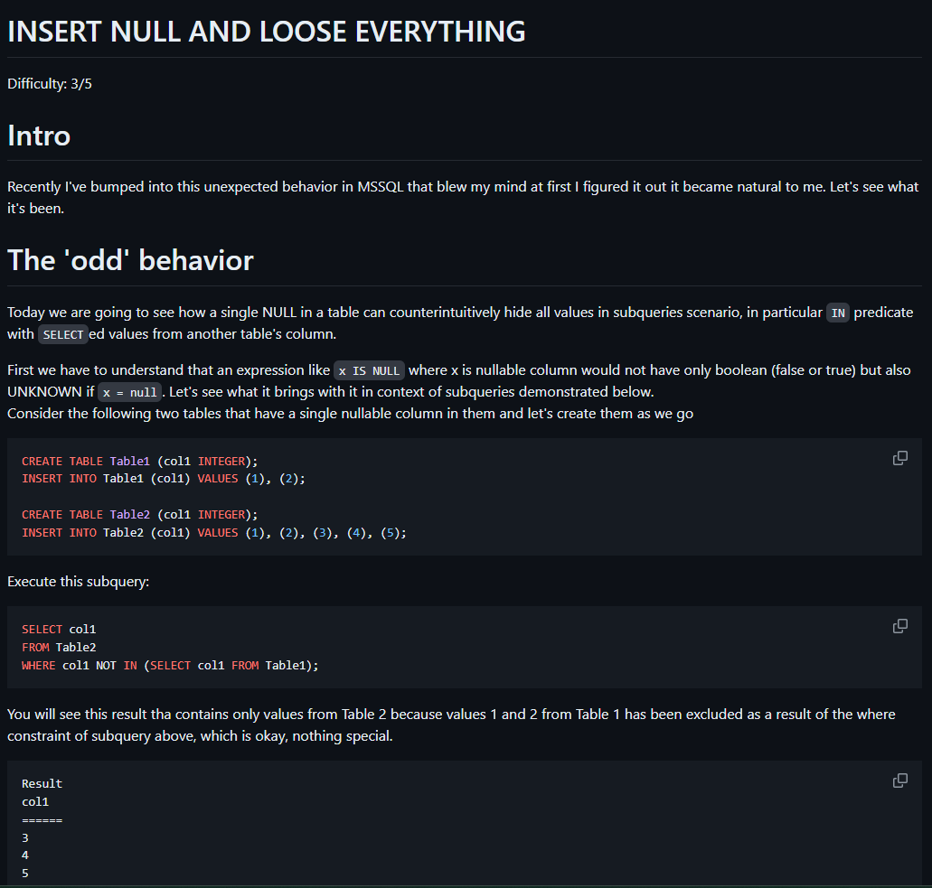
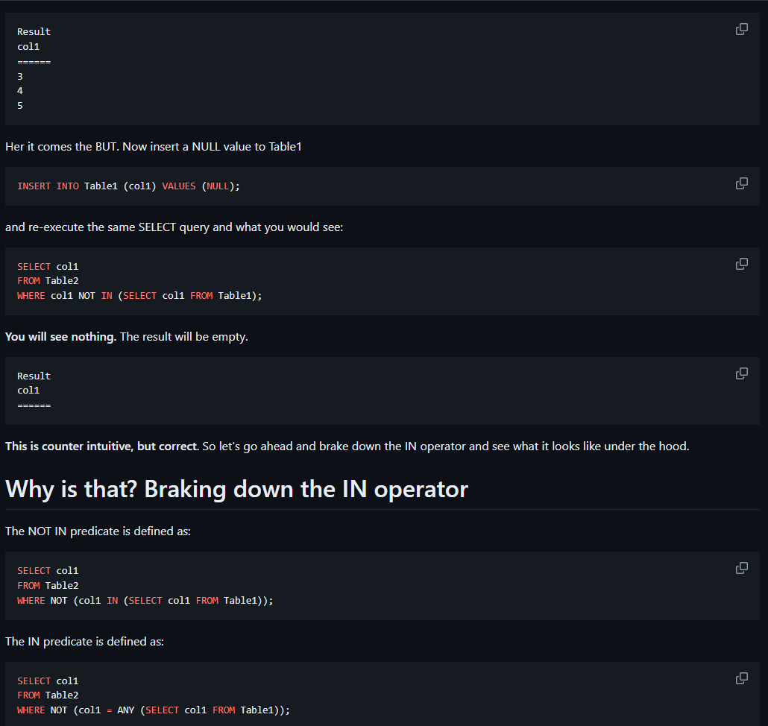
DESIGN AND DOCUMENTATION SKILLS
Knowledge sharing, articles
Nulls and Unknowns behavior in SQL

Slide 18
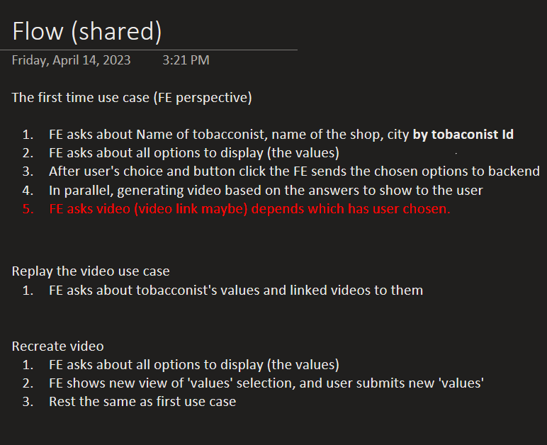
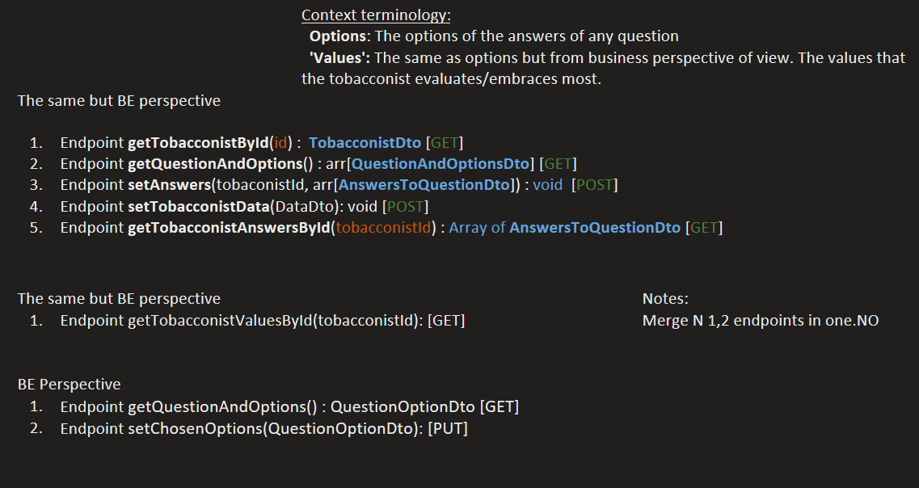
DEV EXPERIENCE: <EPAM Philip Morris> — page 1/3
OVERVIEW
Business
Key facts
Domain – tobacco production
Period of involvement: <STARTDATE> - <ENDDATE>
Team of 4 people (back, front, dev ops, product owner)
Tobacco producer
Main stack: .NET Web API, MSSQL, Docker, AWS
High level Technical architecture
Web API with clean architecture

Slide 19
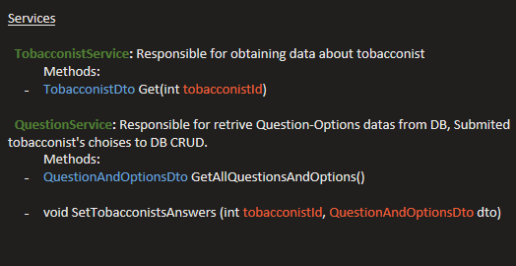
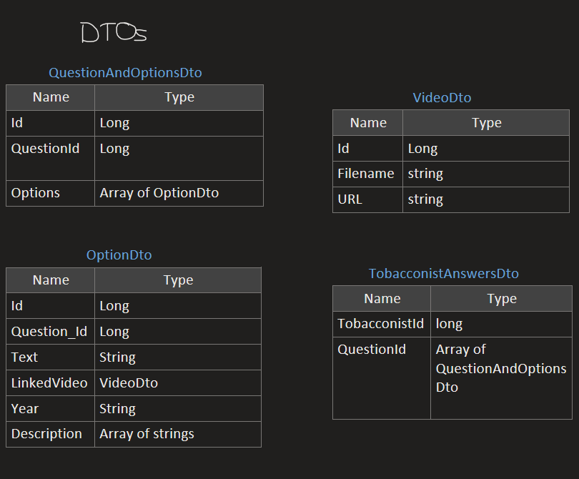
More screenshots : <EPAM Philip Morris> — page 3/3
Schemas
Backend services
Dtos with frontend

Slide 20
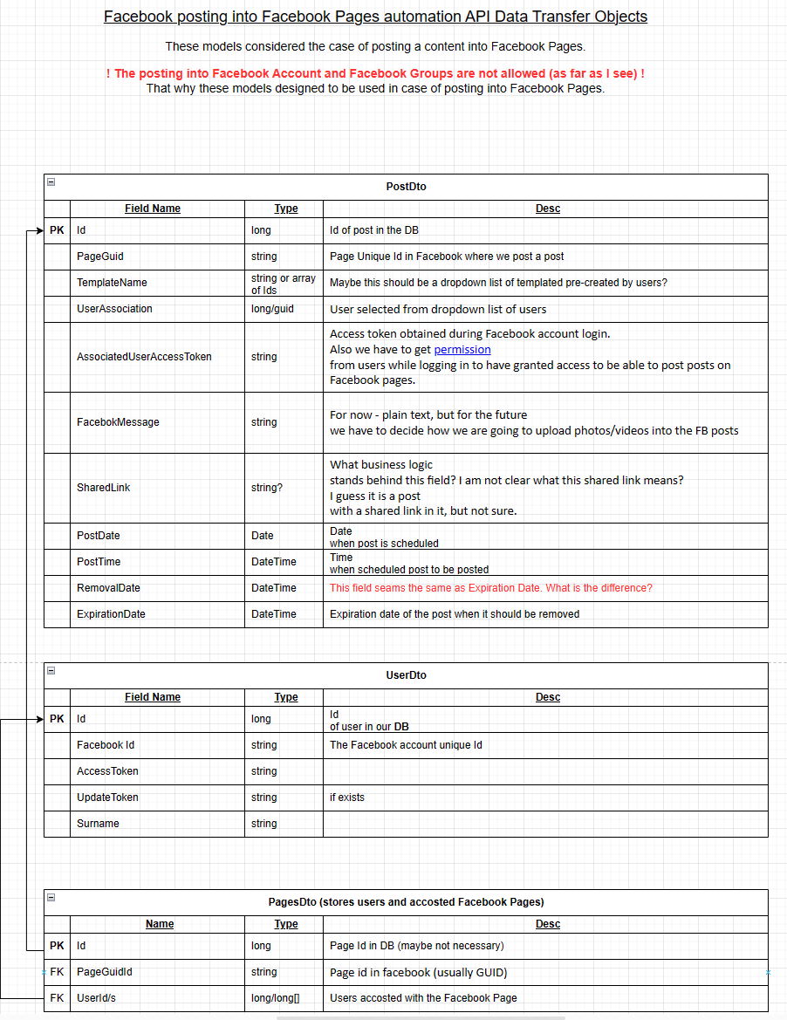
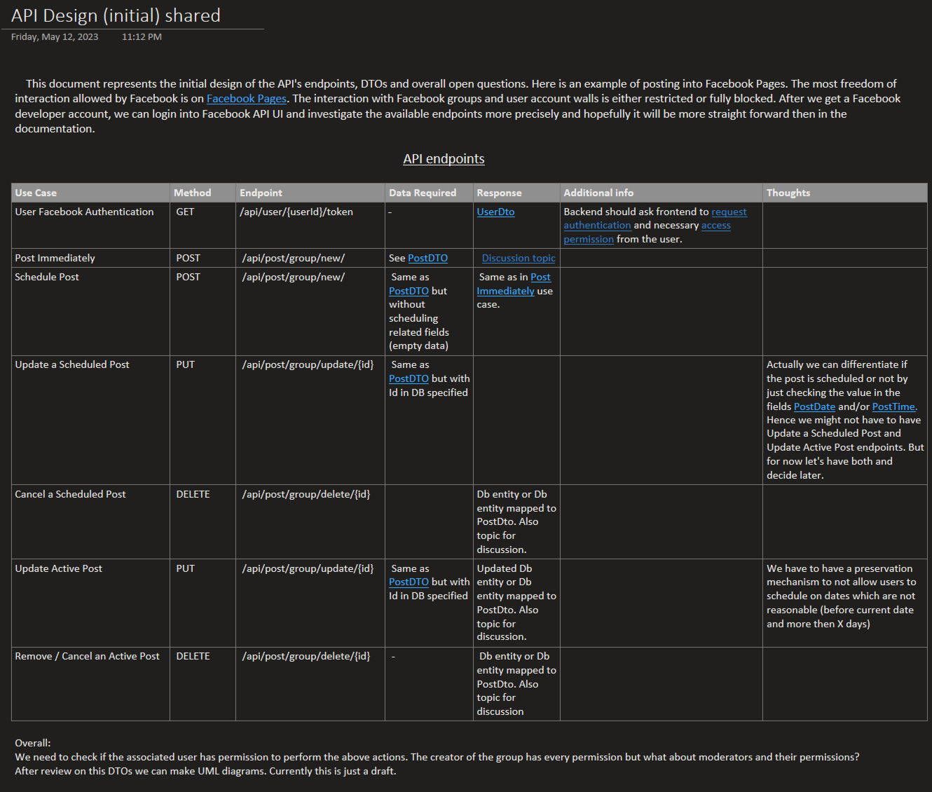
OTHER DEV EXPERIENCE: FB integration — page 1/2
OVERVIEW
requirement
Facebook API research, design system for automated Facebook pages posts for integration the system.

Slide 21
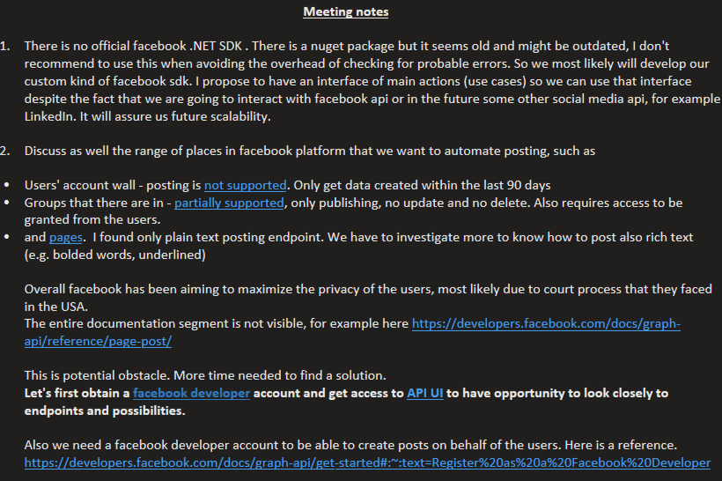
DEV EXPERIENCE: FB integration— page 2/2
More screenshots
Ongoing result notes

Slide 22
Quality
Notes:
QUALITY
L3:
Creates deliverables in good quality
Able to explain what code quality is and how to measure it. Knows code metrics
Has experience in creating efficient unit/component/integration tests
Follows software engineering best practices and principles, and can explain their benefits (e.g. SOLID, GRASP, DRY, KISS)
Works according to EPAM ENGX practices
Recommended
Has experience in creating end-to-end automated acceptance tests
L4:
Must be a role model for colleagues; creates deliverables in high quality
Able to answer questions regarding how to guarantee the quality of developed solutions
Able to explain how to handle technical debt problem
Knows XP and EPAM ENGX practices and can provide pros and cons for a particular project. Can explain how to apply these on the project
Knows code quality metrics and how to set them up. Uses automated tools

Slide 23
(Still RAW)QUALITY: Overview and My participation
Able to explain what code quality is and how to measure it. Knows code metrics
Has experience in creating efficient unit/component/integration tests
Follows software engineering best practices and principles, and can explain their benefits (e.g. SOLID, GRASP, DRY, KISS)
Works according to EPAM ENGX practices
Following SOLID principals
Covering with unit test vital business parts.
Code Review
<What you did, how did you contribute>
<ENGX experience: set up unit tests, testing pyramid, engineering best practices, etc.>
<Any quality process from development point of view: static code analysis, CI/CD pipelines, code reviews, etc.>
<Any other facts that cover requirements for the position, e.g.
L3: https://kb.epam.com/display/EPMASMT/.NET+Discipline%3A+Requirements+for+L3+position
L4: https://kb.epam.com/display/EPMASMT/.NET+Discipline%3A+Requirements+for+L4+position >
<etc.>

Slide 24
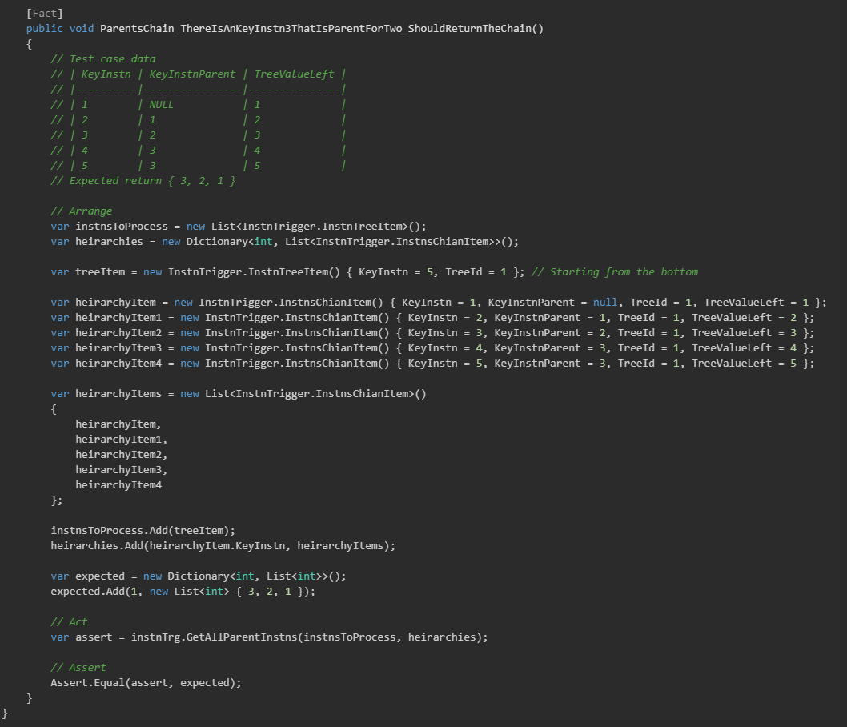
QUALITY: Unit testing
Unit test example

Slide 25
SOFTWARE PROCESS KNOWLEDGE
Notes:
SOFTWARE PROCESS KNOWLEDGE
L3:
Expected to be able to follow and understand a defined software development process
Understands one's role and follows established development processes (e.g. SCRUM, Kanban, Waterfall). Can describe pros and cons for the project
Knows and follows best engineering practices, understands their pros and cons. Can describe which ones are used on the current project
Recommended
Active participation in improving the project's processes (e.g. planning, delivery)
L4:
Expected to be able to follow, understand, and enhance a defined software development process
Knows theory of and able to implement SDLC phases, SCRUM, Kanban, Waterfall, etc. in a team. Can compare them and evaluate which is better for a specific project
Can organize team work and get things done
Experience in setup or enhancement of development process according to best engineering practices, with at least one example
Recommended
Has knowledge and experience in organizing planning process
Has knowledge and experience in enhancing the delivery process
Has experience participating on pre-sales activities

Slide 26
SOFTWARE PROCESS: Overview <e.g. the team and you, and any diagram>
Example manager/ customer
QA group
3rd party vendor developers
Product managers
Solution architect group
I’m here
SA 1
DM 1
Lead QA
QA
Developer
Important manager

Slide 27
SOFTWARE PROCESS: My participation
In enterprises
Participated in sprint plannings, retrospectives, story point evaluation, daily standups. Made changes into work items content if was necessary.
In pet project
As it was demonstrated, made work items, performed code review, managed other developer’s work and scope of required changes.

Slide 28
FINAL WORDS

Slide 29
SUMMARY. Why I’m ready for the next position
HIGLIGHTS
ROLES PLAYED ON A PROJECT – My last position on Epam project was a Key Developer and in the current is senior. Also, I played role of Project coordinator and architect’s role on my side non-profitable fitness application project.
DEVELOPMENT EXPERIENCE AND KNOWLEDGE – My main goal in knowledge transfer is to explain thing that I wish it had been explained to me by setting topic’s boundaries, locating key aspects so the lister can connect the dots, understand scope of the topic and “draw” a map in mind and then filling the space with details but not going outside of the scopes by that avoiding unrelated/unnecessary thoughts and questions. (Maybe, mention about some published article, posts)
DESIGN, ARCHITECTURE AND DOCUMENTATION SKILLS – I can explain solution pros and cons in terms of time, effort, justified effort, expendability and maintainability. My vision is – go as simple as possible unless it is necessary to make code comply certain patterns and architectural principals. We should deliver working product that is agile and easy to change, instead of going fast initially and then struggle with early architectural designs which hard to foresee if it is justified.
RELIABILITY – I can work without supervision and able to predict potential issues and ask clarifying questions ahead. Also, I’m able to answer aroused questions by myself by looking at the code, commit history, etc. Codding is the latest thing to do.

Slide 30
Ready to answer your questions Thank you!

